Slide 1
Virtual Desktop Assistant

Slide 2
Abstract:
There is huge Advancement in the Technical field which is increasing day by day. In early days there were only computer systems where we were able to perform only few tasks, but today new technologies like Artificial intelligence, and few some others have made computer systems so advance that we can perform any type of task with them.
In recent years, Artificial Intelligence (AI) have done remarkable progress and its capability is increasing day by day. One of the application area of AI is Natural Language Processing (NLP). Natural Language Processing (NLP) helps humans to communicate with the computer system in their own language. For example, Voice Assistant. But Voice Assistants only done the internet works only, so I have to develop a virtual desktop assistant using python which will help user to perform any type of task without interaction with keyboard. The aim of this project is to study how Virtual Desktop Assistants behaves smartly and can be used to get everyday work done and also be used for educational purpose also .

Slide 3
System Requirements: -
Processesor : i3 or i5
Operating system: Windows 7 to 11 –
Ram : Minimum 4 GB ram –
Storage : 256 gb Or Above –
Mouse,Keyboard - Internet
Technologies Used:
> Pycharm-IDE
> Qt Creator

Slide 4
Modules Used
Speech Recognition:
Speech Recognition library is used for listening to the words spoken by the users that is taken as input from microphone as a source and then process it for finding out its meaning and convert them into text format. This library allows machine system to understand the human language.
Pyttsx3:
Pyttsx3 stands for Python text to speech library is used for making our voice assistant talk to us. It supports common text to speech engines which is like a tool that converts text into speech and makes voice assistant able to talk to its user. I can make it talking in both male and female voices according to requirement.

Slide 5
MODULES
Wikipedia:
I need to use Wikipedia library so that I can get information from Wikipedia on any topic or I can also ask for solution to my query or simply I can perform Wikipedia search for any topic using this library. This Library in python needs Internet connection for fetching results and it will provide results to user in text as well as voice format.
PyAutoGUI:
PyAutoGUI is a Python Package which has control over the mouse and the keyboard it is able to simulate the mouse cursor moves as well as clicks the button press. With the help of particular 2-D coordinate we can click on exact location on screen.

Slide 6
MODULES
PyWhatkit:
PyWhatKit is a Python Library which has number of features like Sending messages, images through WhatsApp, playing YouTube videos, converting image to ASCII, sending emails etc.
OS:
OS (Operating System) module in Python is used for interacting with operating system. Particularly we are using the ‘Start file ()’ to open any application that are installed in our system.
These are some of the modules used for making Virtual Desktop Assistant that can perform very common features.

Slide 7
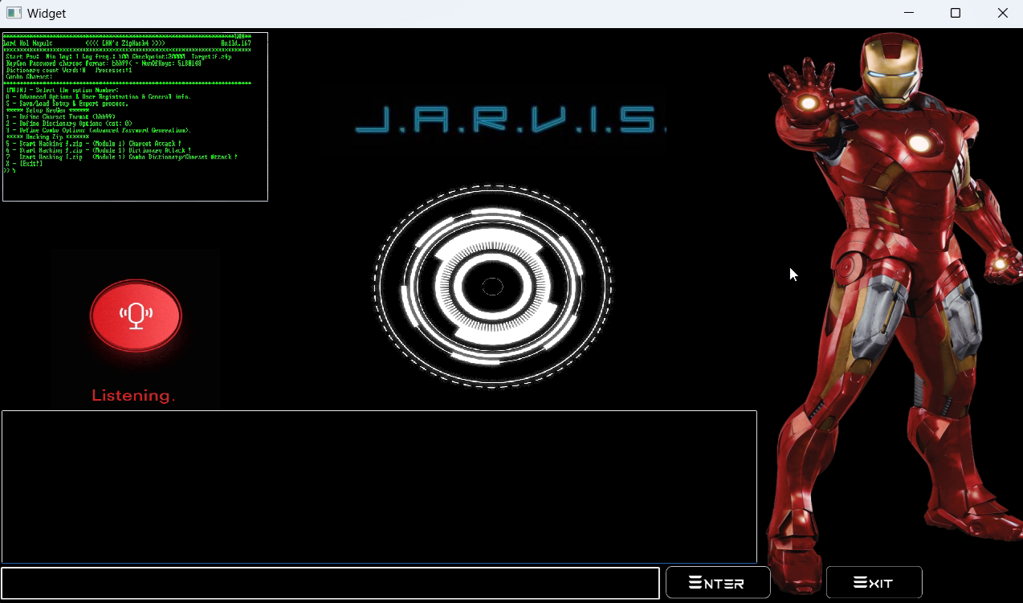
MainGUI

Slide 8
Existing Work
Despite the various benefits provided by speech recognition, the system is also plagued with limitations. By implication the development of speech recognition applications also inherits these limitations. The existing Voice Assistants use pattern recognition techniques of python which lack in the context, Lack of accuracy, and misinterpretations, Time, costs and productivity, User accents. They store the data in database servers which leads to increase in Time and Space Complexity. Some of them use cloud to store the data which leads to security issues. Background noise interference is also another daunting problem with speech recognition software.
And the voice assistants are only perform a internet Tasks only like google assistant. So user cannot perform any local task in their desktop. And the voice assistants have a limitations for performing the tasks.

Slide 9
Future Work
The proposed system of Virtual Desktop Assistant will solve some issues of existing system as well introduce new features for better quality and usage. So, I have a brief of the new updated version of the Virtual Desktop Assistant. Instead of pattern recognition technique which has been used in previous models, i use Natural Language Processing (NLP) techniques to recognize the text which is context based rather the usual pattern based. This Operates in online as well as offline mode. System application runs on offline mode, whereas web based operations run on online mode. Data is Stored in Application itself, rather than cloud which reduces Time and Space Complexity. It even reduces the economic cost due to reducing high bundles of data usage.

Slide 10
Uses
1. Developing for different languages and different accents.
2. Portability for any environment.
3. Voice authentication technology can be implemented for more security.

Slide 11
Conclusion
“Virtual Desktop Using Python” i discussed the design and implementation of Digital Assistance. The project is built using open source software modules with Visual Studio Code community backing which can accommodate any updates shortly. The modular nature of this project makes it more flexible and easy to add additional features without disturbing current system functionalities.
It not only works on human commands but also give responses to the user based on the query being asked or the words spoken by the user such as opening tasks and operations. It is greeting the user the way the user feels more comfortable and feels free to interact with the voice assistant.

